Slide 1



“
www.acsinfotech.com

Slide 2








25 years Old Company in Application Development
Working with Automobile Dealerships in India since 1997
70+ Professionals. Own offices in Delhi, Hyderabad and Bangalore
PROFILE
Over 400+ Dealerships across India are our Customers for DMS & CRM
Over 260+ Dealerships use our CRM Application for:
● Insurance Renewal Follow up
● Service Marketing
● Enquiry Generation & Tracking and Used Car business
● Dealers of MSIL, Hyundai, Toyota, Tata, Honda Cars, HMSI, Mahindra, Chevrolet, Escorts etc…
Implemented e CRM Application overseas at Suzuki Saudi Arabia, Suzuki Nigeria, Suzuki Panama and Suzuki Costa Rica

Slide 3

WHY US?

Slide 4
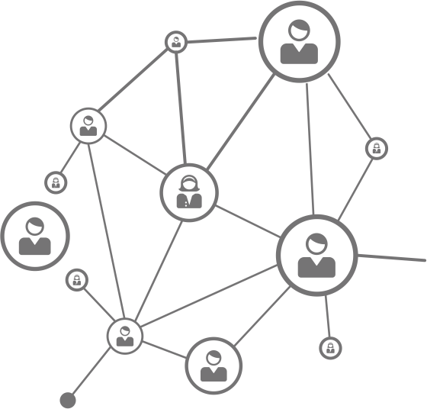



e CRM INSURANCE
A WEB BASED CUSTOMER RELATIONSHIP MANAGEMENT SYSTEM:
● Close monitoring and aggressive follow up of customers for:
■ Insurance Renewal
■ Service Marketing
■ Enquiry for purchase of new vehicles.
● Creating, Updating and accessing a UNIQUE-centralized- customer-database for a dealership with complete history of a customer from: v Enquiry v Sales, v Service v Insurance.
● Creating more opportunities for upselling and cross-selling of services and products during each interaction with the customer.
● Giving instant information to Top Management at all remote locations for critical decision making.

Slide 5

e CRM INSURANCE
COMMON CHALLENGES FACED BY INSURANCE TEAM AT A DEALERSHIP
● Data Management – need to focus on Roll Over customers, new visitors at workshops & Non visiting Customers
● Uncaptured Data – Data from Checkup camps, Vehicles for evaluation, Third party data
● Loss of enquiry if NO TIMELY FOLLOW UP.
● High cost of Hardware & software maintenance at all operational units.
● Need for Dynamic monitoring – Post-mortem Vs In-process Working
● Quality improvement of calls done by tele-callers – Review Call logs for quality check
● Ensuring high margins inspite of decreasing commission. Replace cash discount with Freebie Coupons for Workshop services
● Improve call center efficiency & reduce cost – Use Dialer to increase number of calls / tele-caller

Slide 6





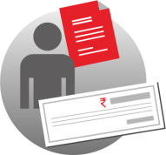


e CRM INSURANCE
FOLLOW-UP PROCESS
Send Personalized SMS/ Email/ Insurance Reminders
Define future follow-up plans
Close the case as Bought / Lost / Do not Contact
Upload policy Information
Outbound calls to Prospects
Generate Appointment report for Field Executives / “Pickers”.
Update payments received
Auto creation of action plan for future

Slide 7
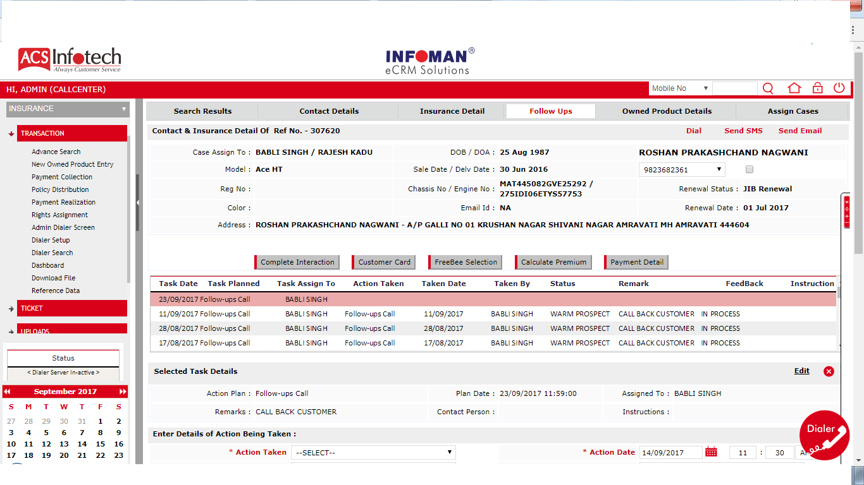
e CRM INSURANCE
FOLLOW-UP PROCESS
■ Follow-ups done by the Tele-callers can be entered as “Action Taken” & “Next Action Plan”
■ Users can also view Follow-up History.

Slide 8






e CRM INSURANCE
KEY FEATURES
Dashboard
Graphical Display Of Insurance Conversions, Appointments fixed , Enquiries received etc.
Smart Communication
Dialer
Auto SMS and Bulk SMS
Auto Mails and Auto Reports
Freebie Module
Coupon Issue & Tracking
Tagging
Printing
Redemption
Mobile Applications
Payment Module
Payment Entry
Payment to Insurance company
Dealer Commission
Back Office operation
Cheque Deposit
Payment Realisation
Policy Distribution
Field Executives for Appointments & Payment Collection

Slide 9
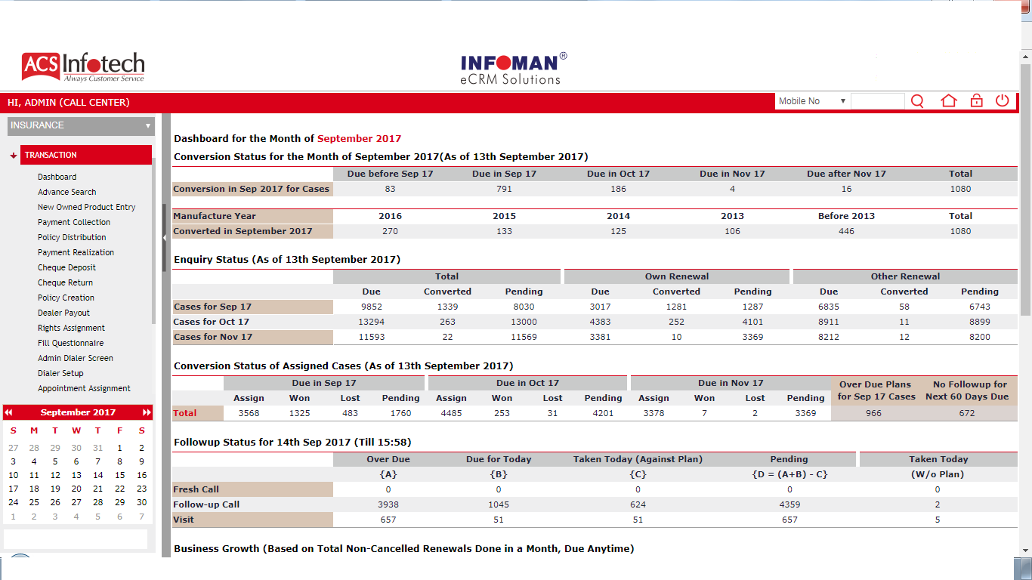
e CRM INSURANCE
DASHBOARD
Quick view of number of conversion done, number of follow-up’s, Enquiry Status as well as business growth.

Slide 10
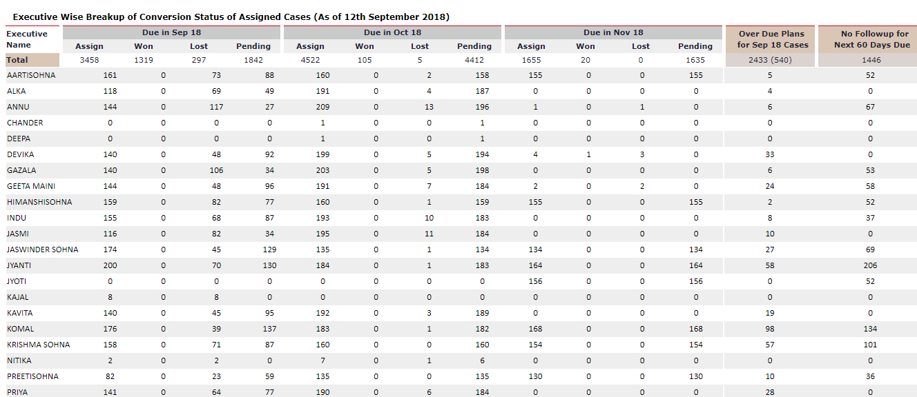
e CRM INSURANCE
EXECUTIVE CONVERSTION
■ View from the Dashboard shows number of cases converted for renewal by executives..

Slide 11
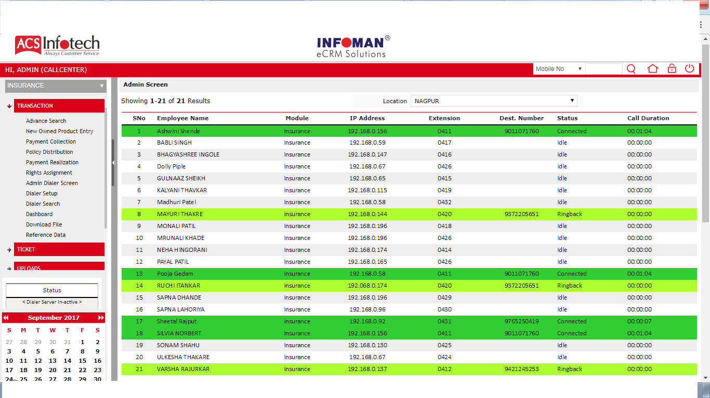
e CRM INSURANCE
ADMIN DIALER SCREEN
■ Admin can monitor status of the Live-calling being done by Tele-callers.
■ Voice Recording – v monitor quality of calls v training of tele-callers v Call Barging, whispering and conference.

Slide 12
e CRM INSURANCE
AUTOMATED REPORTS
Dynamic Monitoring performs “Result Centric Analysis” eg. Track number of calls and Appointments Fixed by tele-callers to measure productivity . Auto reports are generated and sent automatically to defined email Ids for analysis and timely corrective actions. These include:
■ Dialer Summary Report
■ Hourly Calling Report
■ Insurance Over Due Plan Report
■ Insurance Payment Received Report Action DateWise
■ Productivity Report
■ Insurance No Follow-up Report

Slide 13
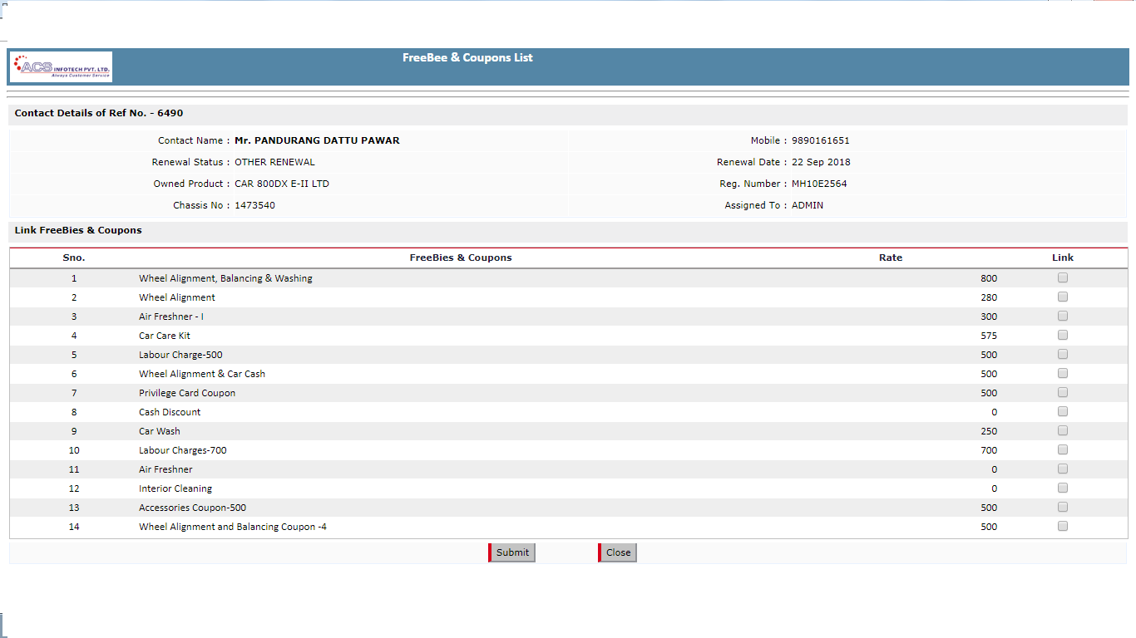
e CRM INSURANCE
BENEFITS OF FREEBIE MODULE
■ Reduces Cash Outflow , Perceived value of service provided is higher than actual cost.
■ Increases Footfall in Workshops thus Workshop Revenue also
■ Infoman eCRM issues, prints & track redemption of Coupons, eliminating misuse
■ Send Reminders for expiry of Freebie coupons to build perception of trust with Customer

Slide 14




e CRM INSURANCE
BENEFITS OF MOBILE APPLICATION
Lists Pending Plans at login itself
View contact details of the customer.
Access policy details & Proposal given on the go.
Update Payment Details after collection.
View latest appointments fixed for Customer Meeting & Payment Collection

Slide 15
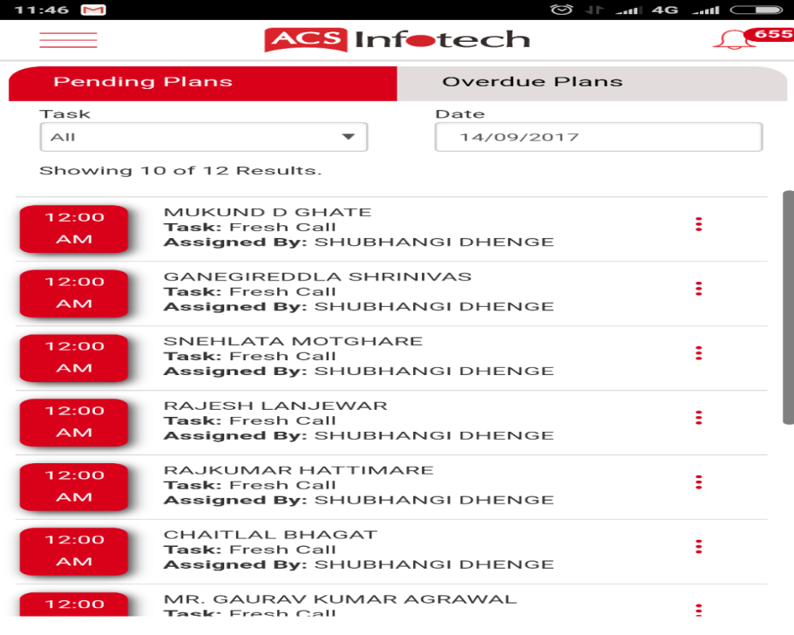
e CRM INSURANCE
PENDING PLAN SCREEN
Plans assigned to executive are displayed

Slide 16
e CRM INSURANCE
PAYMENT MODULE
Update details of Payment Received from the Customer
Record details of Payment made to Insurance company
Compute Commission earned on each Policy sold and reconcile with Insurance company

Slide 17
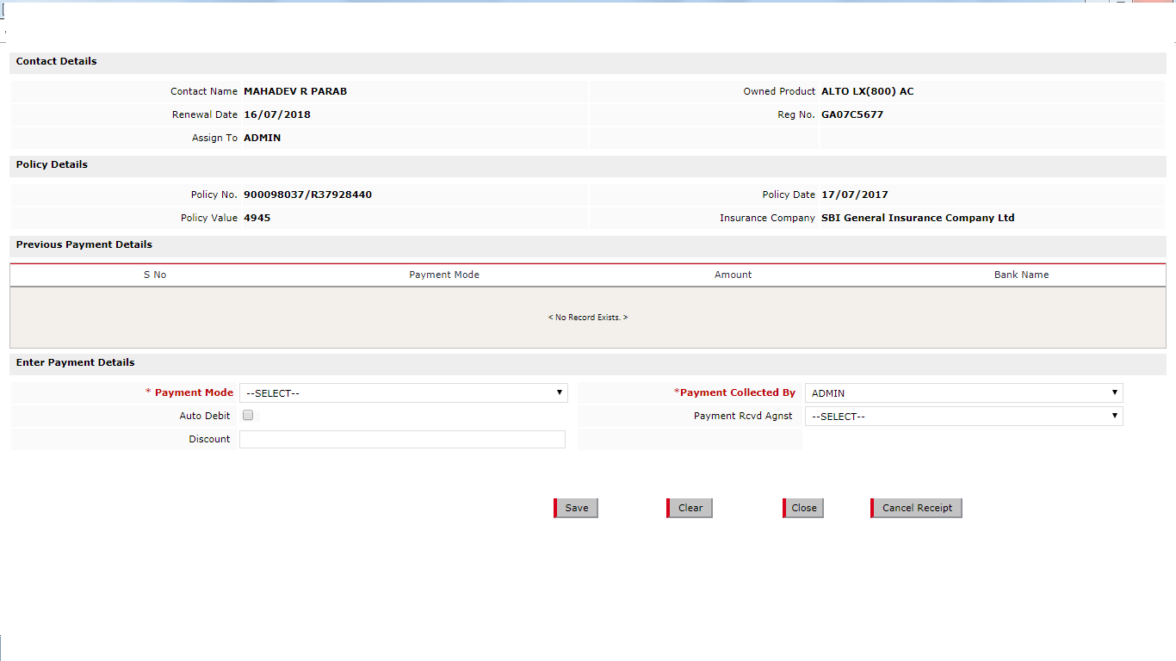
e CRM INSURANCE
PAYMENTS RECEIVED

Slide 18
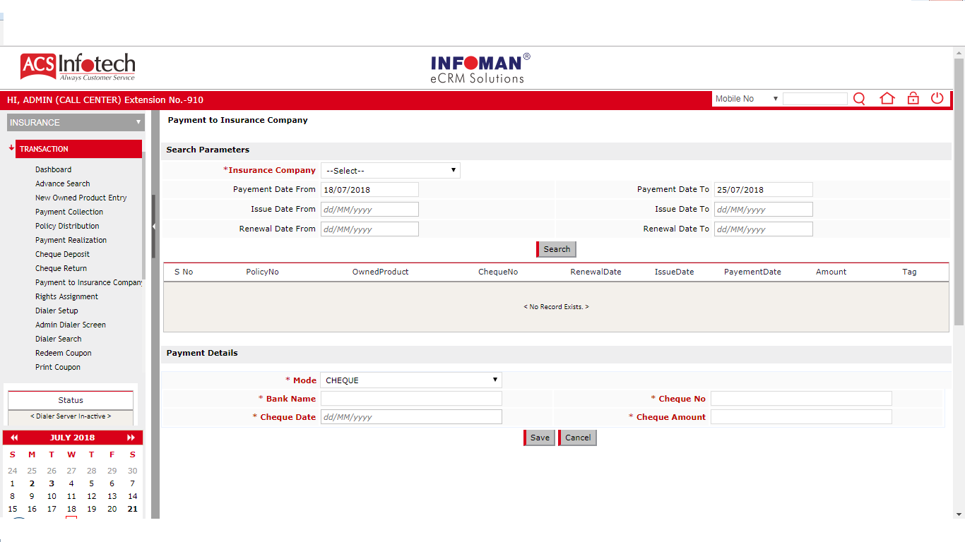
e CRM INSURANCE
PAYMENT TO INSURANCE COMPANY
Track payments to be made to Insurance company

Slide 19
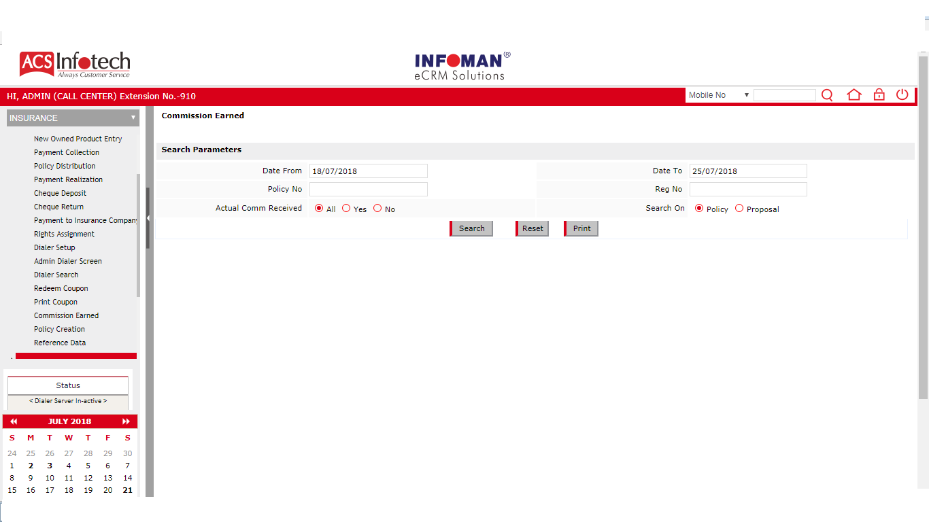
e CRM INSURANCE
DEALER COMMISSION
Generate Dealer Commission due during a period

Slide 20





e CRM INSURANCE
BACK OFFICE OPERATIONS
Proposal Creation
Cheque Deposit Updation
Policy Distribution
Payment Collection
Payment Realisation Marking

Slide 21


THANK YOU!
support@acsinfotech.com
www.acsinfotech.com

